Slide 1
Kids Help Phone

Slide 2
Kids Help Phone is Canada’s only 24/7, bilingual nationwide service offering professional counselling, referrals and volunteer-led text-based support for young people, across Canada.
Notes:
Kids Help Phone is Canada’s pioneer and leader in e-mental health solutions for young people. We are known for our expertise and continuous innovation as Canada’s only 24/7 bilingual professional counselling, information and support services for youth.

Slide 3
Since 1989
We’re continually adapting to meet young people where they’re at.
1989
2010
2012
2014
2018
PHONE
4 WEBSITES
GOOD 2 TALK
SERVICE LAUNCH
RESOURCES
AROUND ME
TEXTING
LAUNCH
ASK US
ONLINE
LIVE CHAT PILOT
ALWAYS
THERE APP
BRO TALK
2015
2002 –
2015
2011
2013
Notes:
Kids Help Phone has a vision to create a future where every young person in Canada will access the support they need, in the way they need it most.
This means a commitment to continually innovate and adapt to the communications technologies and needs of the youth we serve.

Slide 4
Core Services
Phone
Provides young people across Canada with 24/7, bilingual professional counselling, information and referrals – providing a safe and trusted place for young people in any moment of crisis or need.
Live Chat
Allows young people to connect one-on-one, in real time, with a counsellor through our website or from a smartphone, available 24/7/365.
Crisis Text Line powered by Kids Help Phone
Utilizes volunteer Crisis Responders who have completed 36 hours of rigorous online training. Kids Help Phone’s professional supervisors are available to provide in-the-moment coaching to the volunteers and connect with emergency services or child welfare, if required.
Notes:
Kids Help Phone has a vision to create a future where every young person in Canada will access the support they need, in the way they need it most.
This means a commitment to continually innovate and adapt to the communications technologies and needs of the youth we serve.

Slide 5
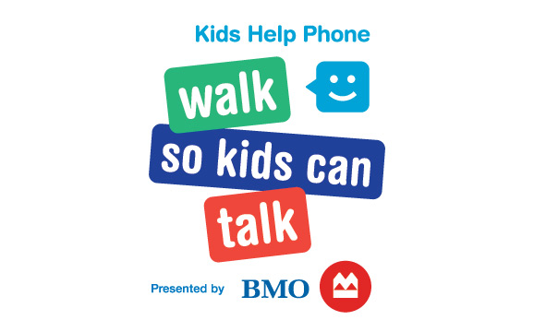
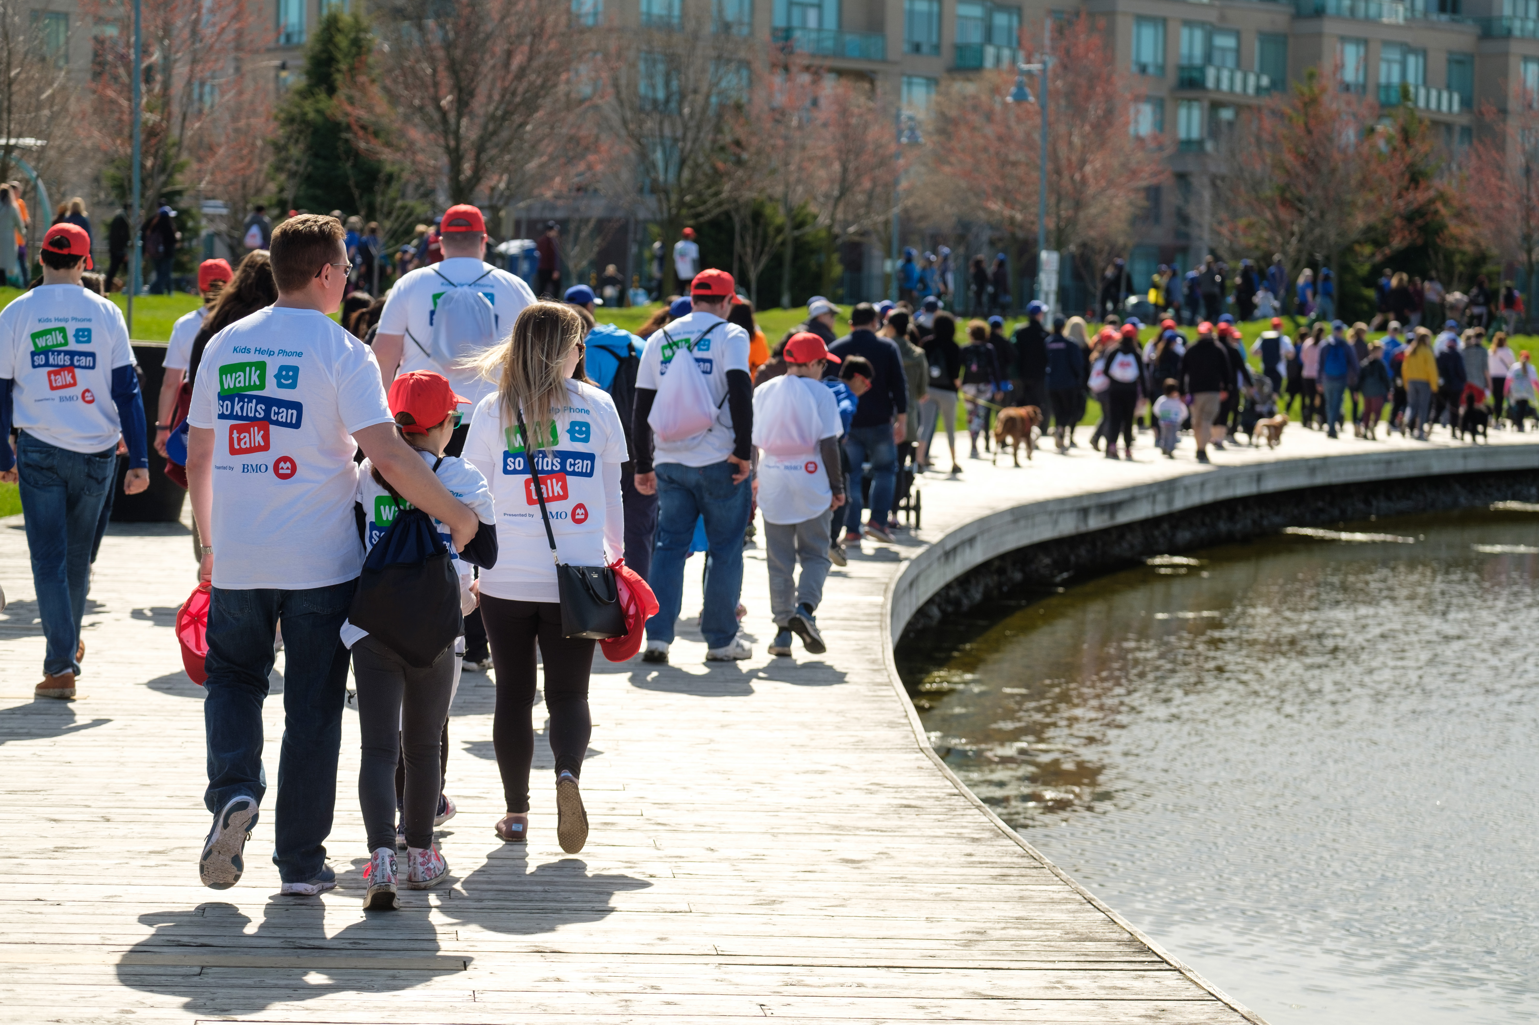
Sunday, May 3
5K Walk, family-friendly event, 40+ communities across Canada
Largest and only national fundraising event for Kids Help Phone
Large corporate audience
Day of community action in celebration and support of youth mental health
Approximately raises 20% of operational budget

Slide 6
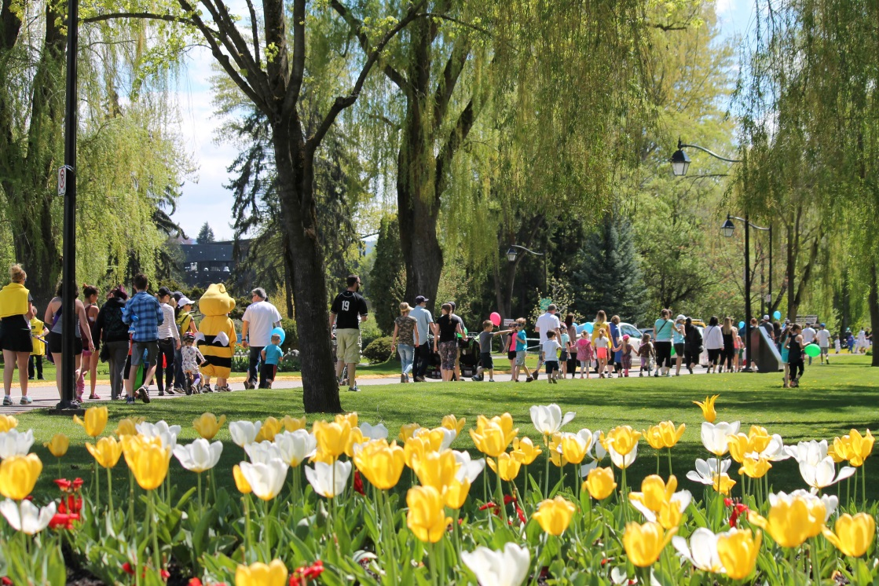
Industry Trends & Data Needs
THE WHY
Funds raised through Walks have been on the decline
WsKCT has been steadily increasing by 3%-5% each year
THE WHAT
Lifetime value ranking list for recognition
Donor retention including YOY, lapsing and returning
New participants YOY
Campaign activity. Analyze:
Best time to communicate
When top fundraisers register
When top fundraisers receive pledges
Participants <$0

